Slide 1
Change-point Analysis: Did Global Warming Stop in 1998?
Nicole A Brown
School of Computing Sciences

Slide 2
Contents
Background and Aim of the project
Related Research
Analysis and Initial Testing
Simulation Design
Findings and Conclusions
Further Work
Considerations

Slide 3
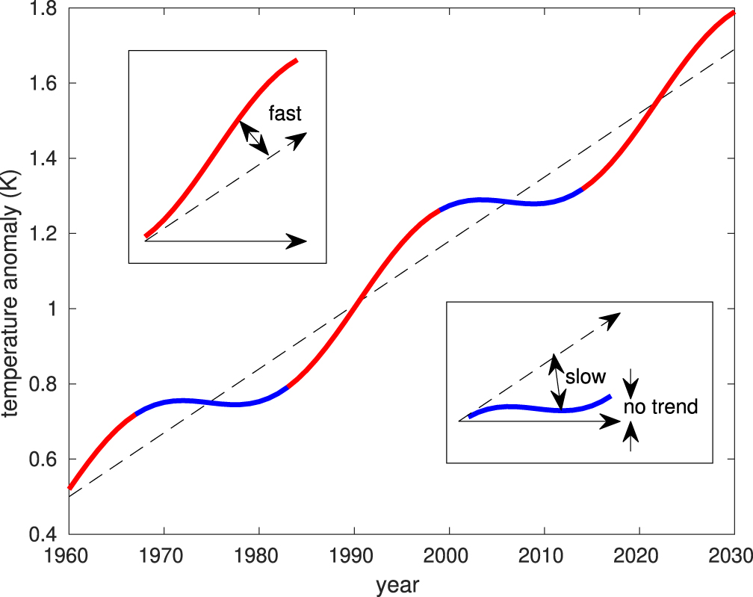
Background and Aim of the project
Accelerated global warming since industrialisation.
Claims of change-point in 1998 despite increased greenhouse gas emissions.
Contradictory definitions of a change-point.
Natural Variation: ENSO, volcanic activity and solar cycle.
Change-point tests non-robust in presence of autocorrelation.
Plot generated in R from HadCRUT4 Monthly averages 1850 to present.
Risbey et al. (2018) smoothed GMST series with linear trend plus sinusoidal variation to mimic multidecadal fluctuations.

Slide 4
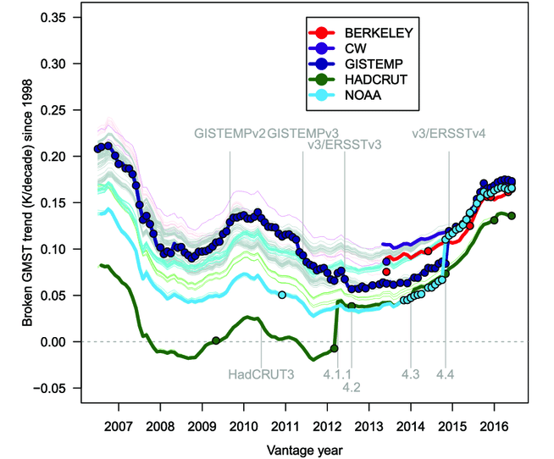

Related Research
Non-robustness of the Chow test under autocorrelation. Simplified Chow test statistic where SS is the sum of squares, τ is the total number of observations and k is the number of parameters:
$F= \frac{(SS− {SS}_{1}−{SS}_{2})/k}{{(SS}_{1}−{SS}_{2})(τ−2k)}$,
Durbin-Watson test for detection of autocorrelation.
Differences and limitations of GMST datasets.
Effect of selection bias: prior knowledge of change-point and effect of period tested on results.
Lewandowsky et al. (2018) historically conditioned trends for major GMST datasets. Each solid line plots the best-fitting least squares trend from the start year of 1998 to the end year (vantage year) as shown on the x-axis. The thick lines for each dataset correspond to the version available and current at a given vantage year, with the vertical grey lines indicating major changes in version.

Slide 5
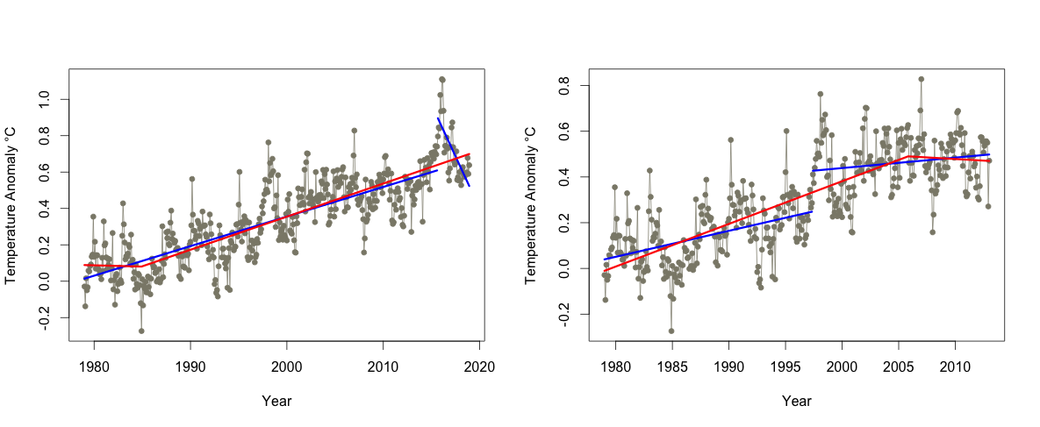
Analysis and Initial Testing
Broken and unbroken methods of change-point tests developed in R.
Results from different time periods shown in table.
Time series analysis of GISTEMP and HadCRUT4 in R comparing ACF plots and performing Durbin-Watson test.
Seasonality in monthly analysis.
Plot from R of broken and unbroken change-point tests on HadCRUT4 monthly averages over different time periods.
Monthly HadCRUT4 1979 to 2013
Broken CP Test | Min p value = 6.473433e-13 | Change-point in mid 1997
Unbroken CP Test | Min p value = 3.881362e-06 | Change-point in late 1984
Monthly HadCRUT4 1979 to Present
Broken CP Test | Min p value = 2.252245e-11 | Change-point in late 2015
Unbroken CP Test | Min p value = 0.0005440062 | Change-point in late 1984

Slide 6

Simulation Design
Monte Carlo simulations with error variable changing.
Synthetic data model based on analysis of HadCRUT3 data:
$$\text{temperature} \text{= }β_{0}\text{+ }β_{1}\text{∗}\text{time} \text{+} \text{ε}$$
White noise:
$$\text{ε}\text{ ∼}\text{WN}\text{( 0,} { \text{σ}}^{2}\text{) }$$
With autocorrelation:
$$\text{ε}\text{ ∼} \text{AR}\text{(1)}$$
AR plots more realistically mimic GMST data.
False positive rates of change-point tests.
Transition plot of HacCRUT4 timeseries used to model synthetic data.
Transition plot of 5 synthetic datasets from white noise model.
Transition plot of 5 synthetic datasets from AR model.

Slide 7
Results and Conclusions
White Noise | Broken Trend | Unbroken Trend
Annual | 14% | 5%
Monthly | 29% | 9%
White Noise | Broken Trend | Unbroken Trend
Annual | 40% | 22%
Monthly | 42% | 28%
False positive rates from simulations in tables.
The presence of autocorrelation increases the false positive rates of change-point tests. Previous claims are not statistically robust.
Higher than expected false positive rates for monthly white noise data.
Not a measure of the power of the tests and may not directly apply to real-world data.
Projection of HadCRUT3 time series based on AR model created in R.

Slide 8
Further Work and Reflections
More robust testing techniques.
Mathematical transformations.
Multiple testing, for different start points.
Apply methods to adjusted datasets such as Foster and Rahmstorf (2011).
Over-simplified models need to be more complex.
High risk due as research influences public and political opinion.

Slide 9
References
Nature (2017). What pause? Nature, 545(7652).
Risbey et al. (2018). A fluctuation in surface temperature in historical context: Reassessment and retrospective on the evidence. Environmental Research Letters, 13:123008.
Krämer (1989). The robustness of the chow test to autocorrelation among disturbances. Statistical Analysis and Forecasting of Economic Structural Change.
Lewandowsky et al. (2018). The ‘pause’ in global warming in historical context: II. comparing models to observations. Environmental Research Letters, 13:123007.
Foster and Rahmstorf (2011). Global temperature evolution 1979–2010. Environmental Research Letters, 6(4):044022.

Slide 10

Thank you For listening.

